Slide 1




SWE
NEXT GEN EMPLOYABILITY PROGRAM
Creating a future-ready workforce
Team Members
College Name
Student Name :SWETHA M
Student ID :510421104308
Arunai engineering college,
Tiruvannamalai

Slide 2

CAPSTONE PROJECT SHOWCASE
Project Title
Building Bus Reservation System using Python and Django
Abstract | Problem Statement | Project Overview | Proposed Solution | Technology Used | Modelling & Results | Conclusion

Slide 3
Abstract
The Online Bus Reservation System (OBRS) is a comprehensive web-based platform designed to streamline the process of booking bus tickets for travelers. The system offers an intuitive user interface that allows passengers to search for available bus routes, view schedules, select preferred seats, and make secure online payments. OBRS integrates with bus operators' databases to provide real-time information on seat availability and pricing, ensuring accurate and up-to-date booking options. Additionally, the system incorporates features such as user registration, ticket cancellation, and itinerary management to enhance the overall user experience. With its convenience, reliability, and efficiency, OBRS aims to revolutionize the way passengers plan and book their bus journeys, ultimately improving customer satisfaction and operational efficiency for bus operators.
Source :

Slide 4
Problem Statement
Design and develop an online bus reservation system that allows users to easily search for bus routes, view schedules, book tickets, make payments securely, and manage their reservations efficiently. The system should cater to both passengers and administrators, providing a user-friendly interface for booking while offering robust management tools for administrators to monitor bookings, manage bus routes, adjust schedules, and handle payments seamlessly. The system should prioritize scalability, reliability, security, and user experience to ensure a smooth and convenient booking process for all stakeholders.
Source :

Slide 5
Project Overview
Title: Online Bus Reservation System
Introduction : The Online Bus Reservation System is a web-based platform designed to streamline the process of booking bus tickets. It offers users the convenience of booking bus tickets from anywhere with an internet connection, reducing the need for physical ticket counters and long queues. The system aims to provide a user-friendly interface for both customers and administrators, ensuring efficient management of bus routes, schedules, ticket availability, and passenger information.
Key Features:
User Registration/Login
Bus Route Management
Booking Management
Ticket confirmation
Ticket cancellation
Source :

Slide 6
Proposed Solution
.
User Registration/Login: Allow users to create accounts or login using their credentials.
Seat Selection: Enable users to select seats from an interactive seat map, highlighting available and booked seats.
Booking Process: Once seats are selected, proceed with the booking process, where users provide passenger details, contact information, and payment details.
Confirmation: Upon successful payment, provide users with a booking confirmation along with their ticket details via email or SMS.
Security Measures: Implement robust security measures to protect user data and payment information, including encryption, secure connections (HTTPS), and compliance with data protection regulations.
Customer Support: Provide responsive customer support through live chat, email, or a helpline to assist users with inquiries, issues, and emergencies.
Source :

Slide 7
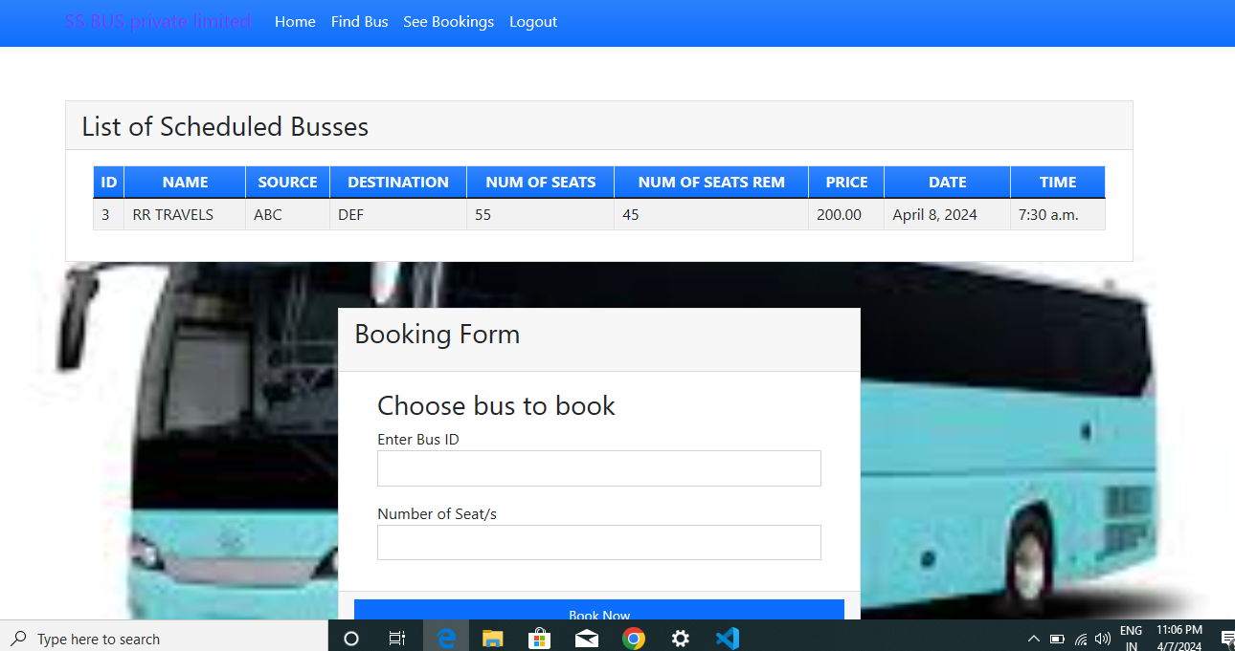
Source :

Slide 8
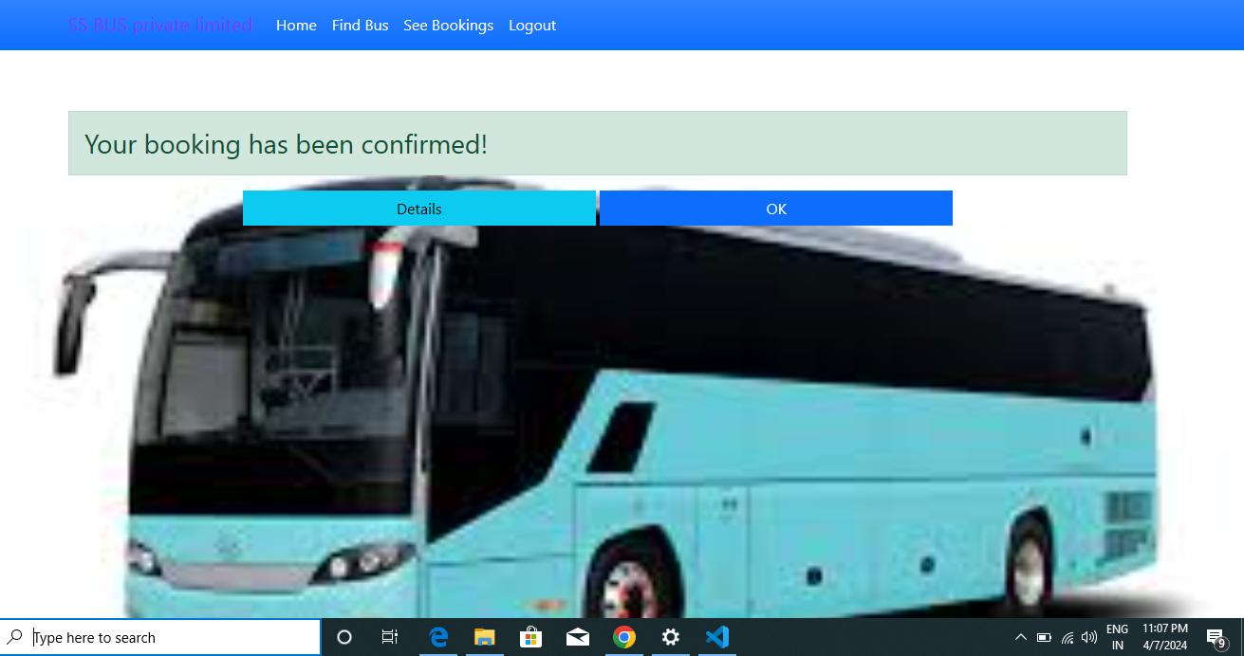
Source :

Slide 9


Technology Used
Front-end
Back-end
Source :

Slide 10
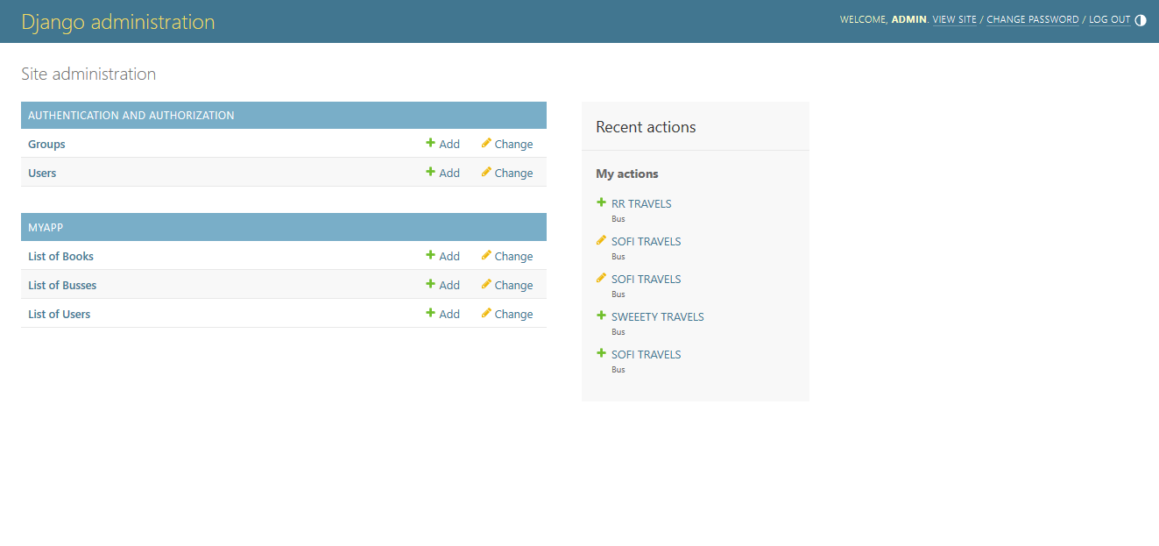
Modelling & Results
Source :

Slide 11
Future Enhancements:
Dynamic Pricing: Implementing a dynamic pricing system that adjusts ticket prices based on demand, time of booking, and other factors could optimize revenue and better manage capacity.
Mobile Ticketing: Introducing mobile ticketing options, including QR codes or NFC technology, for easier and contactless ticket validation.
Feedback and Rating System: Implementing a feedback and rating system to collect user reviews and improve service quality continuous.
Virtual Reality Tours: Providing virtual reality tours of buses and seating arrangements to allow users to preview their journey before booking.
Predictive Maintenance: Using IOT sensors and data analytics to implement predictive maintenance strategies, reducing downtime and ensuring the reliability of the bus fleet.
Block chain Technology: Exploring the use of block chain technology for secure and transparent transactions, ticket verification, and managing loyalty programs or incentives."

Slide 12
Conclusion
The implementation of an online bus reservation system offers numerous benefits including convenience for passengers, streamlined booking processes, efficient management of bus schedules, and improved customer service. By embracing digital solutions, both passengers and bus operators stand to gain from enhanced accessibility, reliability, and overall satisfaction with the booking experience.
Source :

Slide 13
Thank You!
Notes:
Thank You !!

